Slide 1

Basic Syntax, Conditional Statements and Loops
SoftUni Team
Technical Trainers
Software University
http://softuni.bg

Slide 2
Table of Content
Basic Syntax and First Steps
Conditional Statements
if, else, elif
indendtation
and, or
is vs ==
Loops

Slide 3
Have a Question?
sli.do
# fund-python

Slide 4

Basic Syntax and First Steps

Slide 5
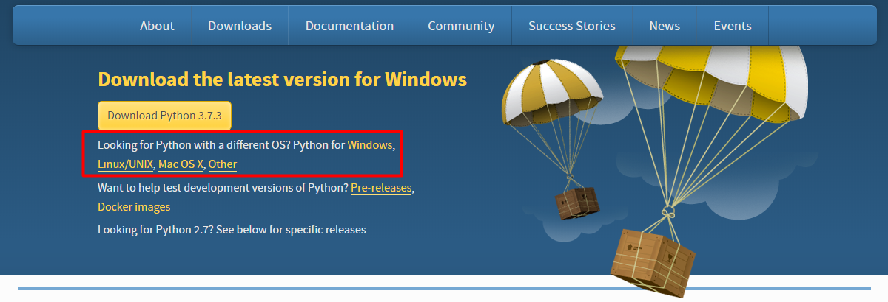
Installing Python
Go to python.org and click the download link depending on your operating system

Slide 6
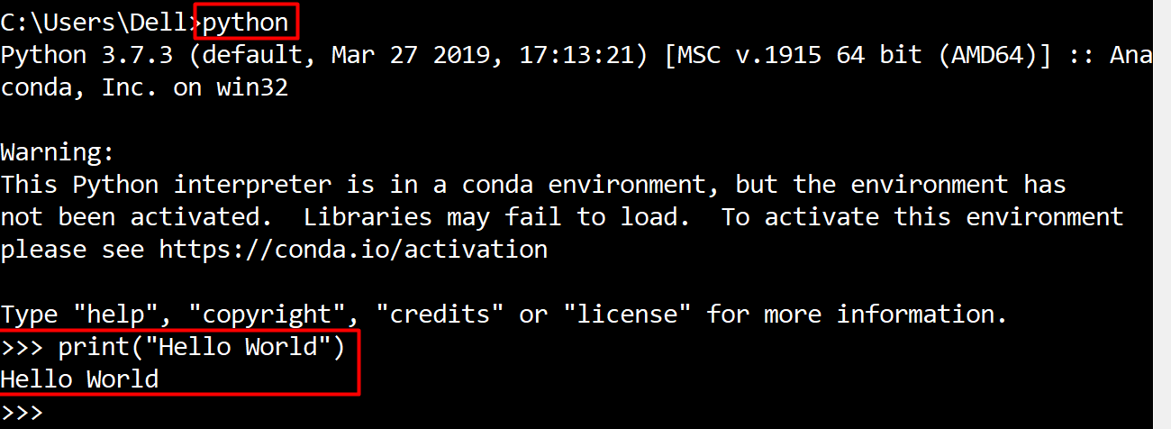
Run Python in Command Prompt
You can code and execute python directly in the command prompt by typing "python" or "py"

Slide 7
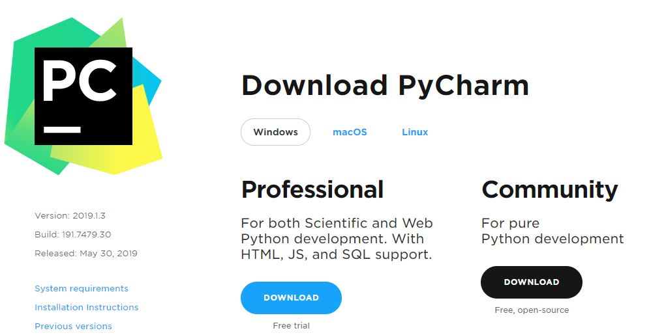
Write Python in IDE
You can also code in Python using IDE (for example: PyCharm)
You can download PyCharm from here: https://www.jetbrains.com/pycharm/download

Slide 8
Basic Syntax
Variables – they are way to store information and are characterized by name, type and value
Data types – variables are used to hold different data types
int - integer number : 1, 2, 3, 4 ….
float - real number : 0.5 , 3.14, -0.5 ….
str - string and chars : "a", "Hello", …
bool - boolean: True, False
age = 25
Name
Value

Slide 9

Conditional Statements
Conditional Code Execution

Slide 10
The If-Statement
An "if statement" is written by using the if keyword.
Python supports the usual logical conditions from mathematics:
Equals: a == b
Not Equals: a != b
Less than: a < b
Less than or equal to: a <= b
Greater than: a > b
Greater than or equal to: a >= b
a = 33 b = 200 if b > a: print("b is greater than a")

Slide 11
Indentation
Python relies on indentation, using whitespace, to define scope in the code.
Other programming languages often use curly-brackets for this purpose.
If statement, without indentation (will raise an error):
a = 33 b = 200 if b > a: print("b is greater than a")

Slide 12
The Else-Statement
The else keyword catches anything which isn't caught by the preceding conditions.
a = 200 b = 33 if b > a: print("b is greater than a") else: print("b is not greater than b")

Slide 13
The Elif-Statement
The elif keyword is pythons way of saying "if the previous conditions were not true, then try this condition".
a = 33 b = 33 if b > a: print("b is greater than a") elif a == b: print("a and b are equal")

Slide 14
And and Or
The and keyword is a logical operator, and is used to combine conditional statements:
The or keyword is a logical operator, and is used to combine conditional statements:
if a > b and c > a: print("Both conditions are True")
if a > b or a > c: print("At least one of the conditions is True")

Slide 15
Check Number Range
If you want to check whether a number is in a given range, you can use the following syntax
a = int(input())
if 1 <= a <= 10:
print("a is in the range 1 and 10")

Slide 16
Problem: Biggest of Three Numbers
Write a program which:
Read three whole numbers from the console
Print the biggest number
Input
Output
3
-1
5
5
Check your solution here: https://judge.softuni.bg/Contests/Practice/Index/1718

Slide 17
Solution: Biggest of Three Numbers
first_num = int(input())
second_num = int(input())
third_num = int(input())
if first_num > second_num and first_num > third_num:
print(first_num)
elif second_num > first_num and second_num > third_num:
print(second_num)
else:
print(third_num)
Check your solution here: https://judge.softuni.bg/Contests/Practice/Index/1718

Slide 18
Problem: Number Definer
Write a program that:
Reads a floating-point number
Prints "zero" if the number is zero
Prints "positive" or "negative". Add "small" if the absolute value of the number < 1, or "large" if the number > 1 000 000.
Input
Output
25
positive
Check your solution here: https://judge.softuni.bg/Contests/Practice/Index/1718

Slide 19
Solution:
number = float(input())
if number == 0:
print("zero")
elif number > 0:
if number < 1:
print("small positive")
elif number > 1000000:
print("large positive")
else:
print("positive")
# TODO
Check your solution here: https://judge.softuni.bg/Contests/Practice/Index/1718

Slide 20

Loops
Repeating Blocks of Code

Slide 21
For-Loops
A for loop is used to iterate over sequence of iterable type like:
tuple
list
other iterable types
The for loop does not require an indexing variable to set beforehand

Slide 22
The range Function
To loop through a set of code a specified number of times, we can use the range() function
for x in range(3): print(x)
# 0
# 1
# 2

Slide 23
The break statement
The break statement stops the loop before it has looped through all the items:
for x in range(3): if x == 1:
break
print(x)
# 0

Slide 24
The continue statement
The continue statement skips the current iteration of the loop, and continue with the next:
for x in range(3): if x == 1:
continue
print(x)
# 0
# 2

Slide 25
While-Loops
With the while loop we can execute a set of statements as long as a condition is true.
Note: remember to increment i, or else the loop will continue forever.
i = 1 while i < 6: print(i) i += 1

Slide 26
Problem: Word Reverse
Write a program that:
Receives a single word from the user
Reverses it and prints it
Input
Output
Python
nohtyP
Check your solution here: https://judge.softuni.bg/Contests/Practice/Index/1718

Slide 27
Solution: Word Reverse
word = input()
reversed_word = ""
for i in range(len(word) - 1, -1, -1):
print(word[i])
reversed_word += word[i]
print(reversed_word)
Check your solution here: https://judge.softuni.bg/Contests/Practice/Index/1718

Slide 28
Problem: Number between 1 and 100
Write a program which:
Reads numbers from the console until it receives a number between 1 and 100 inclusive.
When the correct number is received, stop reading and print "The number {number} is between 1 and 100"
Input
Output
-3
44
The number 44 is between 1 and 100
Check your solution here: https://judge.softuni.bg/Contests/Practice/Index/1718

Slide 29
Solution: Number between 1 and 100
number = float(input())
while number < 1 or number > 100:
number = float(input())
print(f'The number {number} is between 1 and 100')
Check your solution here: https://judge.softuni.bg/Contests/Practice/Index/1718

Slide 30

Live Exercises

Slide 31
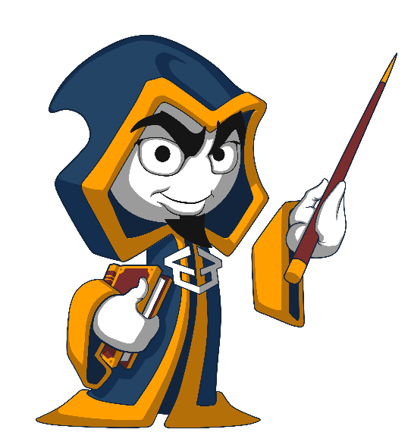
Summary
We learned how to:
execute code based on different conditions
use loops to execute a block of code multiple times on different elements
stop/skip iterations in loops
…
…
…

Slide 32
https://softuni.bg/modules/70/fundamentals-module/1197

Slide 33












SoftUni Diamond Partners

Slide 34




SoftUni Organizational Partners

Slide 35




Trainings @ Software University (SoftUni)
Software University – High-Quality Education and Employment Opportunities
softuni.bg
Software University Foundation
http://softuni.foundation/
Software University @ Facebook
facebook.com/SoftwareUniversity
Software University Forums
forum.softuni.bg

Slide 36

License
This course (slides, examples, demos, videos, homework, etc.) is licensed under the "Creative Commons Attribution-NonCommercial-ShareAlike 4.0 International" license

